Slide 1
E-APPROVAL PROCESS OF KOLON BINH DUONG
Tel : +84-8-3812-2775
Fax : +84-8-3812-2779
Mailto : gwsys@genuwinsolution.com

Slide 2
System Process – Main Process
E-approval | HR System
Register Application (overtime,
Absence, come late, leave early,
Incorrect time, change shift )
Working Time Report
Attendance & Absence
Manager Approve
Process Salary
Final Confirm
Salary Payment

Slide 3
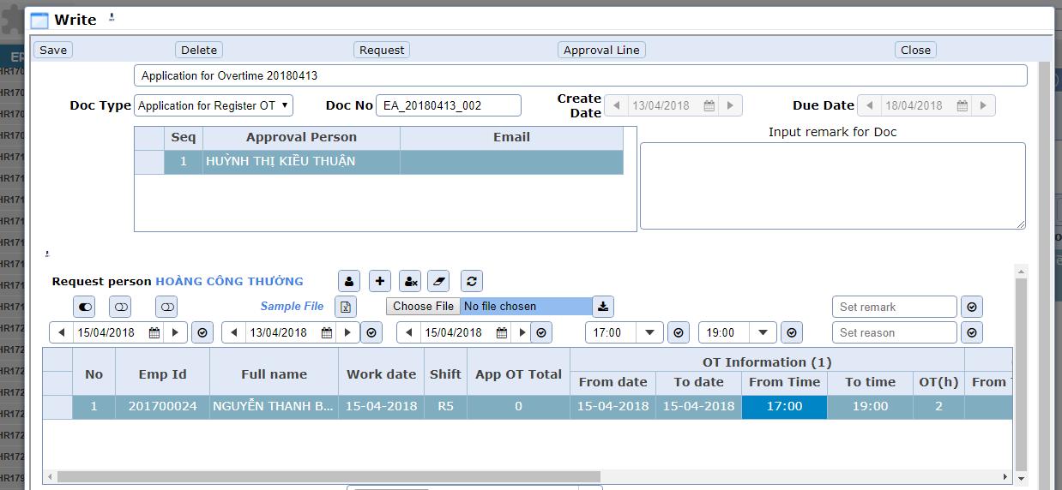
2. Overtime Process
Users register overtime application in e-approval

Slide 4
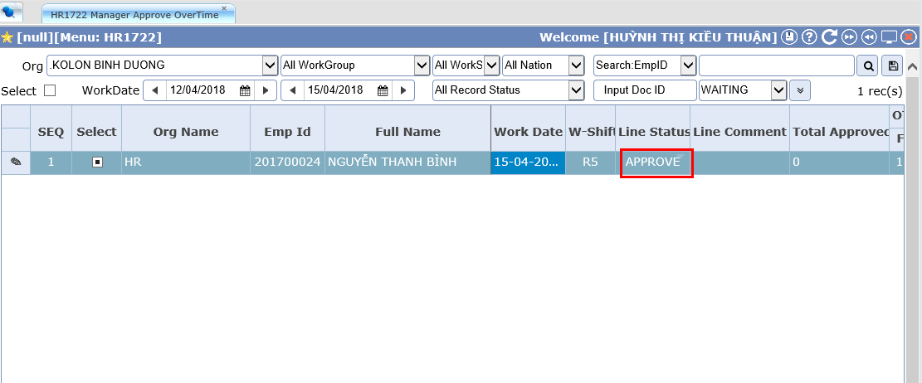
2. Overtime Process
Manangers approve overtime application

Slide 5
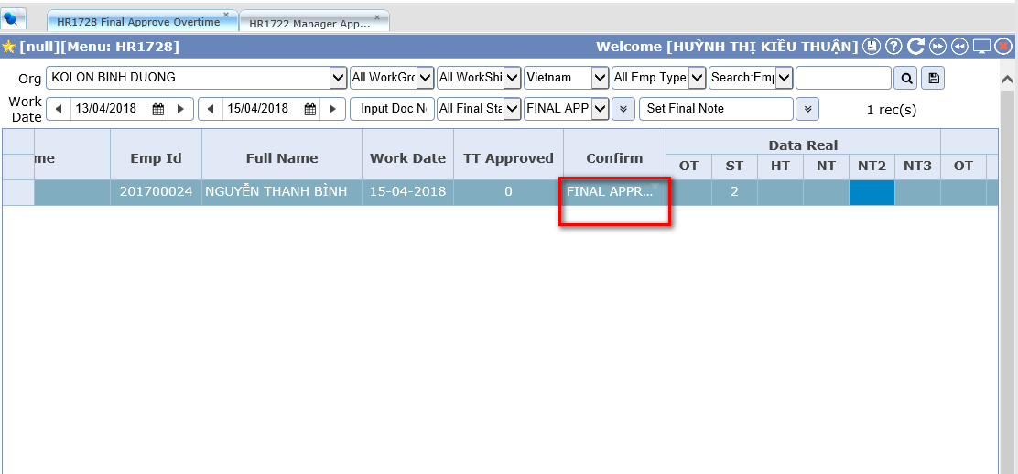
2. Overtime Process
HR staffs make final confirm

Slide 6
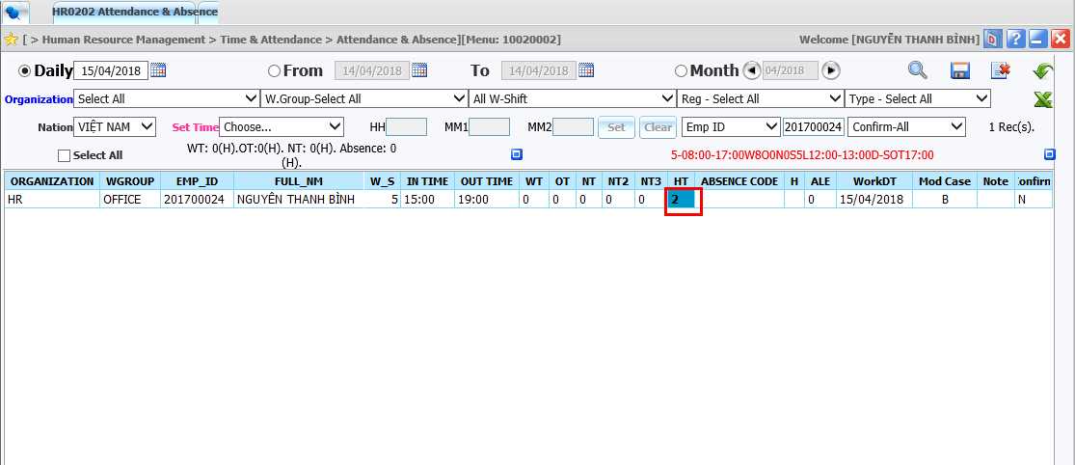
2. Overtime Process
OT data will be applied to attendance & absence of HR system

Slide 7
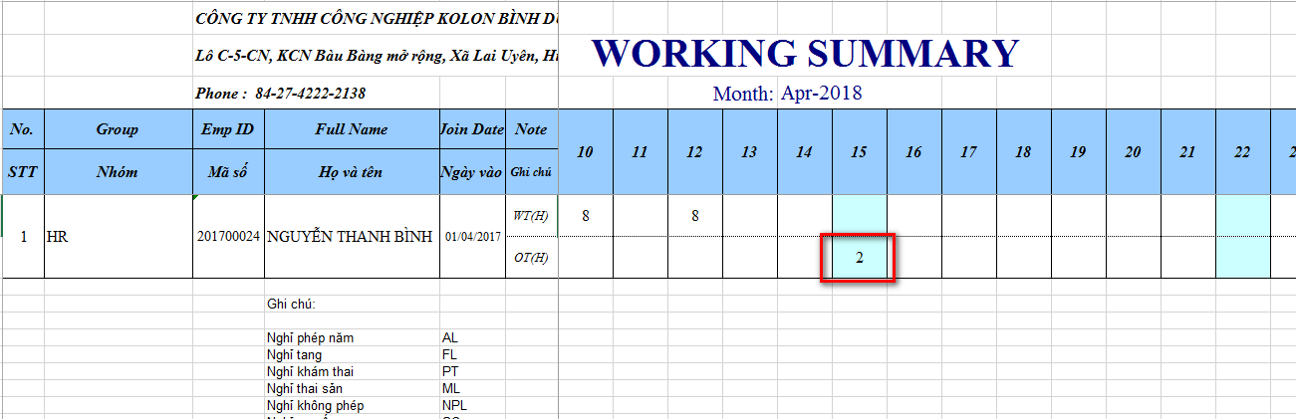
2. Overtime Process
After users process attendance. OT data will be displayed in working summary report

Slide 8
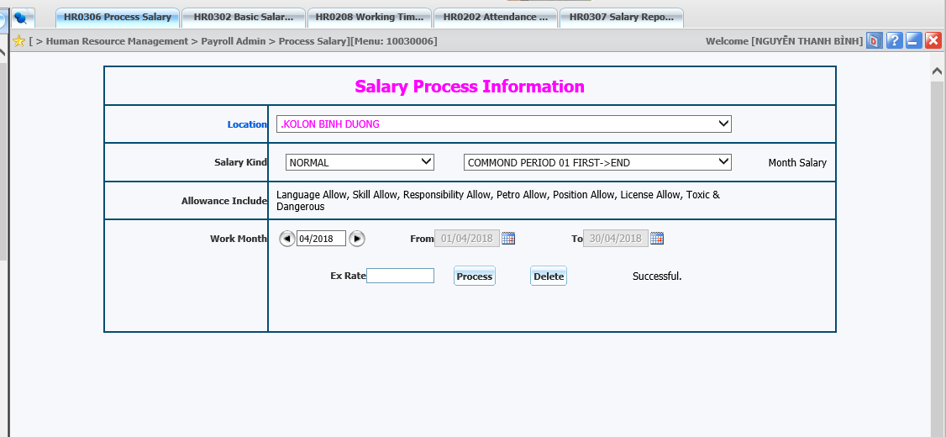
2. Overtime Process
Users process in HR system to calculate salary

Slide 9
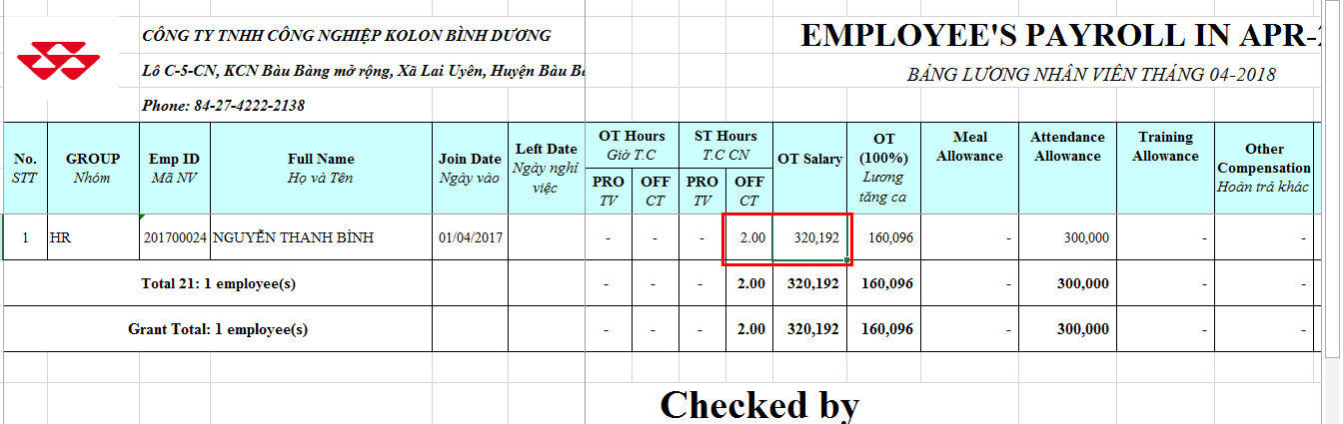
2. Overtime Process
Users can check OT salary in salary payment of HR system

Slide 10
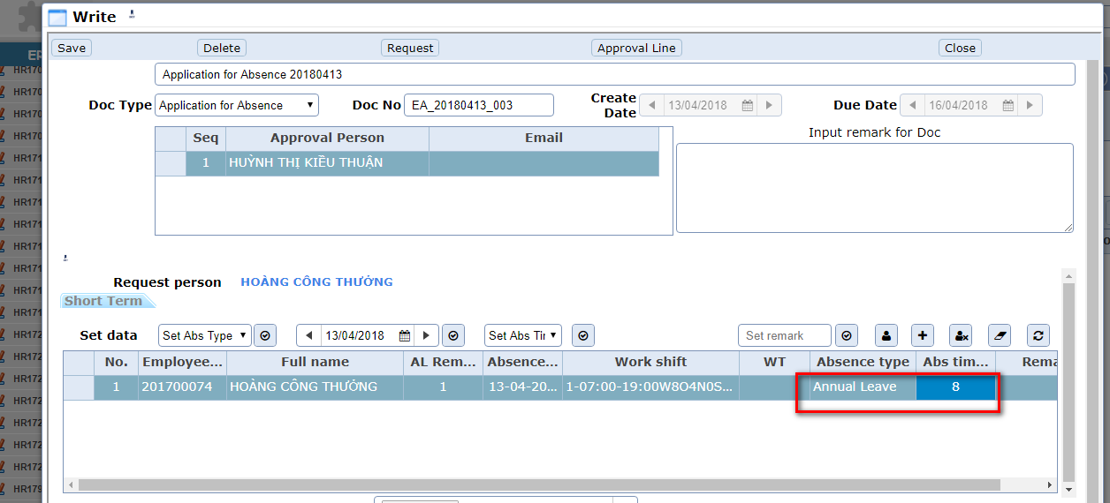
3. Absence Process
Users register absence application in e-approval

Slide 11
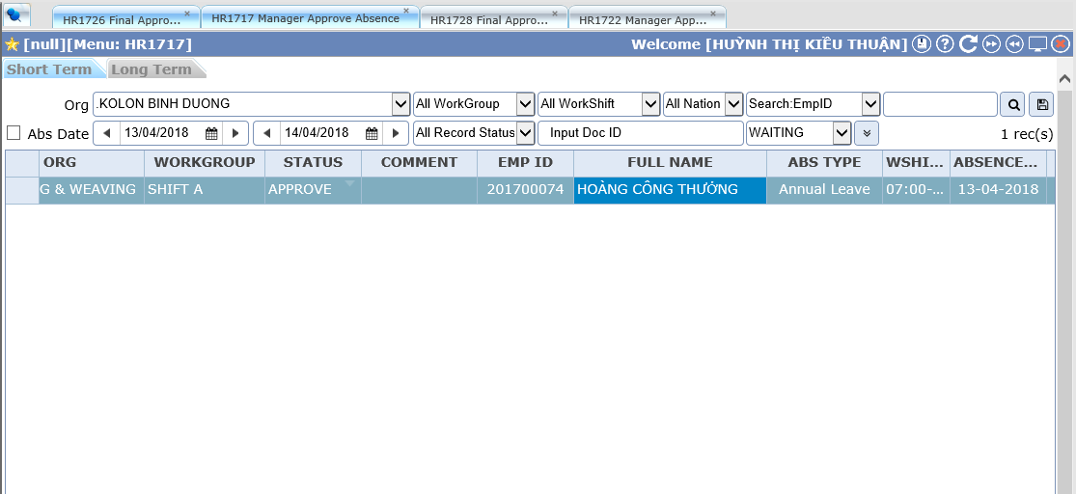
3. Absence Process
Managers approve absence application

Slide 12
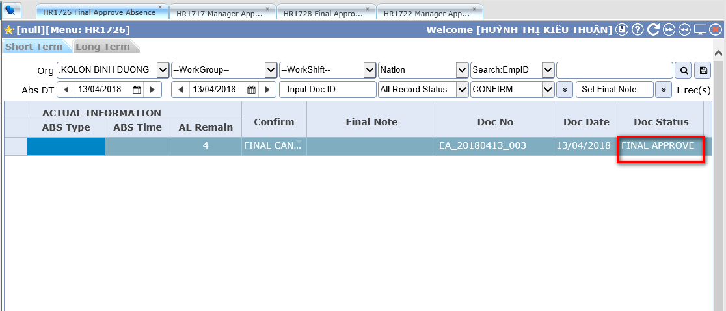
3. Absence Process
HR staffs make final confirm

Slide 13
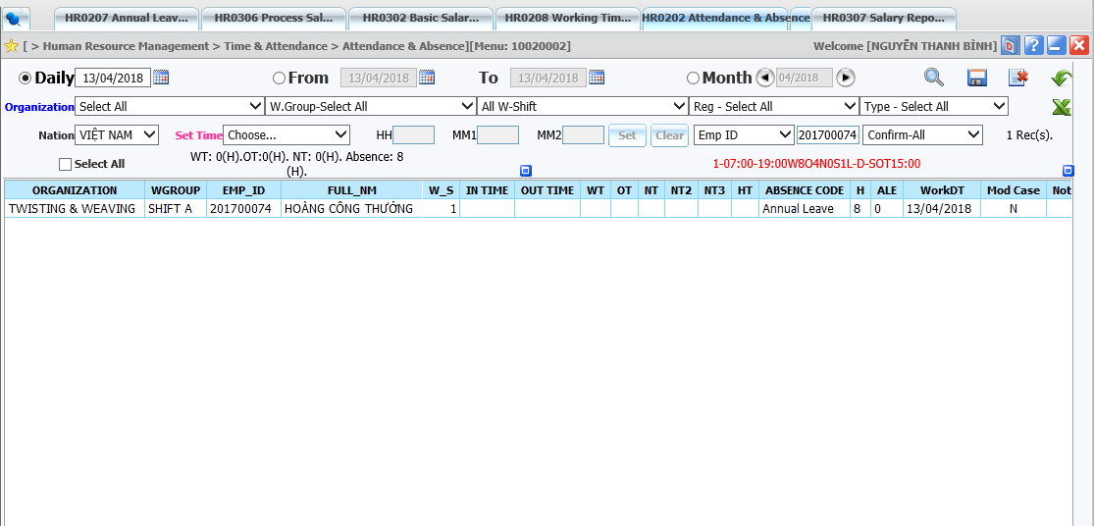
3. Absence Process
Absence data will be applied into attendance & absence of HR system

Slide 14
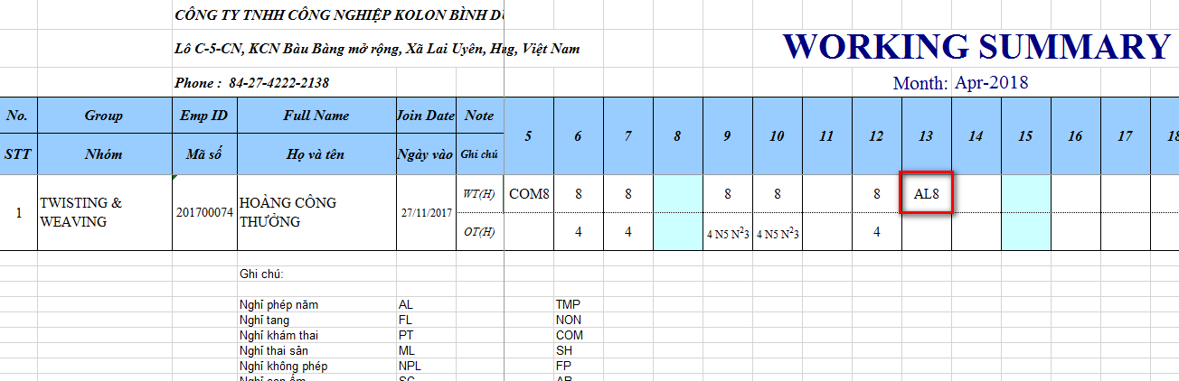
3. Absence Process
Absence data will be applied into salary payment

Slide 15
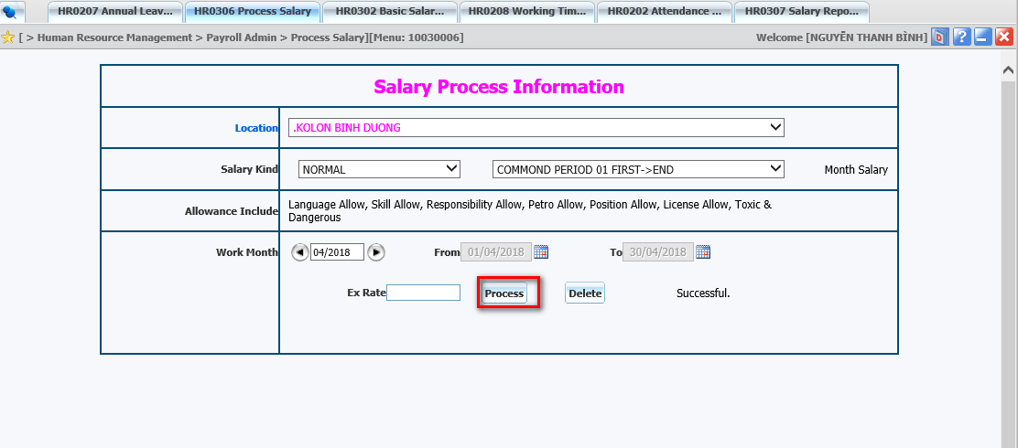
3. Absence Process
Users process in HR system to calculate salary

Slide 16
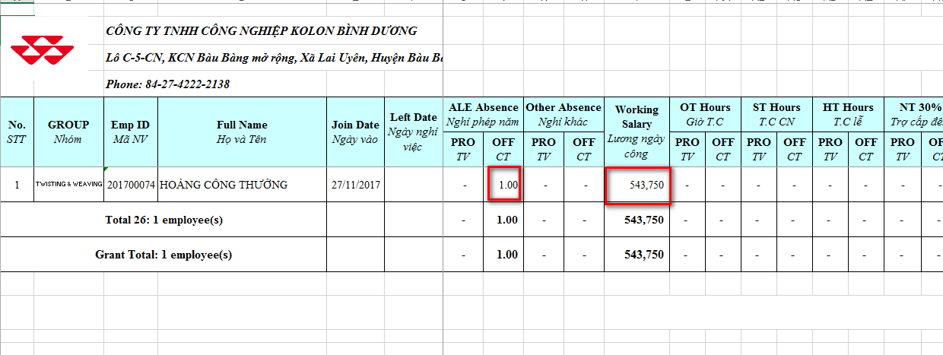
3. Absence Process
Users can check absence salary in salary payment of HR system

Slide 17
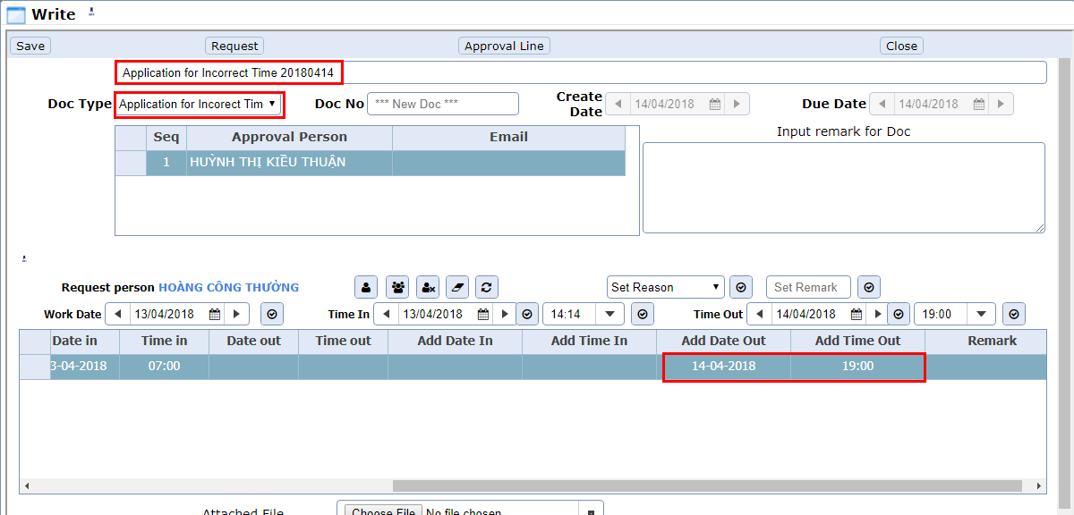
4. Incorrect Time Process
Users register incorrect time application in e-approval

Slide 18
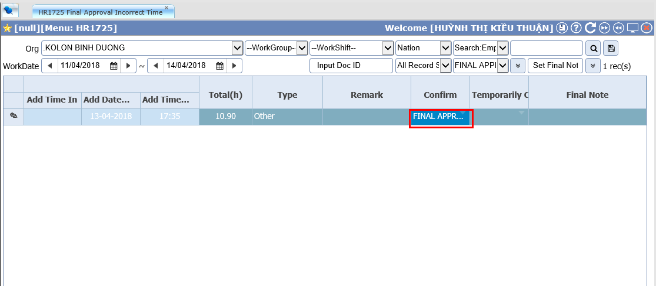
4. Incorrect Time Process
Managers approve incorrect time application

Slide 19
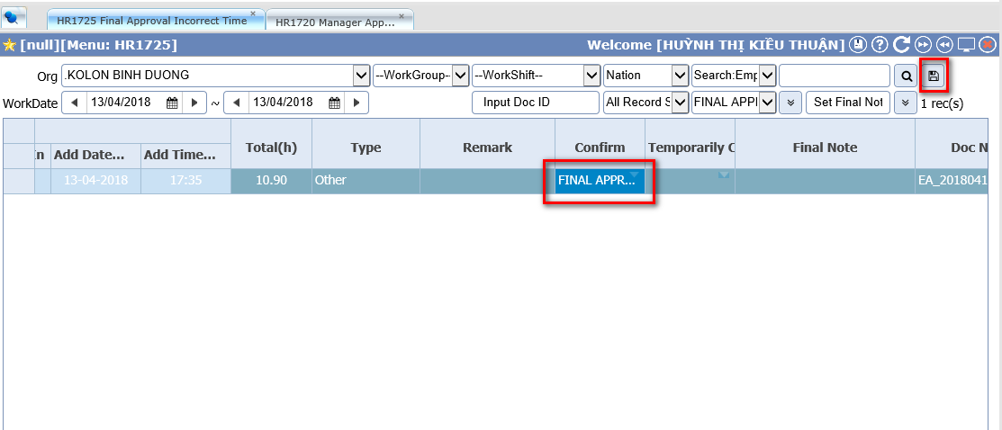
4. Incorrect Time Process
HR staffs make final confirm

Slide 20
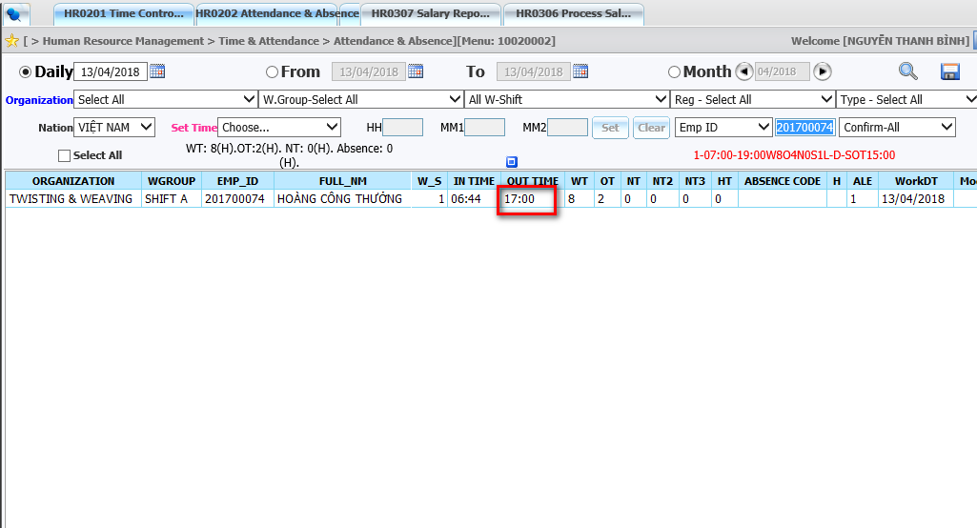
4. Incorrect Time Process
Incorrect Time data will be applied into attendance & absence of HR system

Slide 21
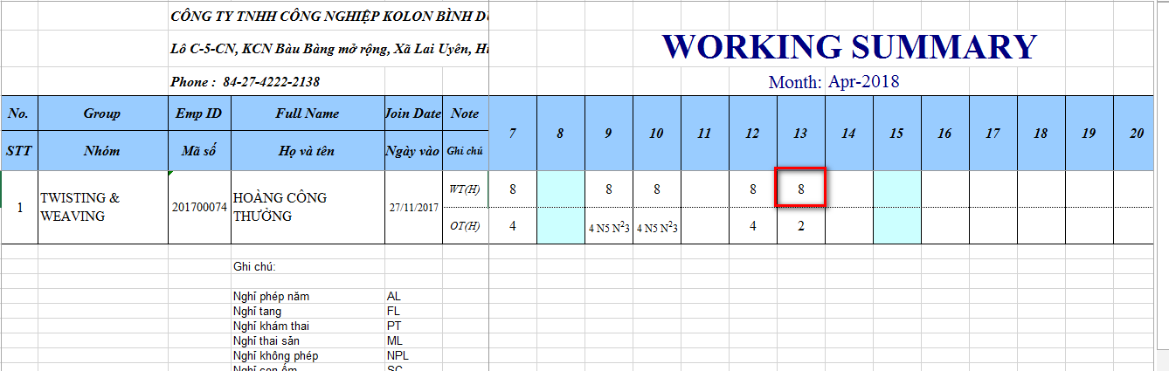
4. Incorrect Time Process
After users process attendance. Incorrect time data will be displayed in working summary report

Slide 22
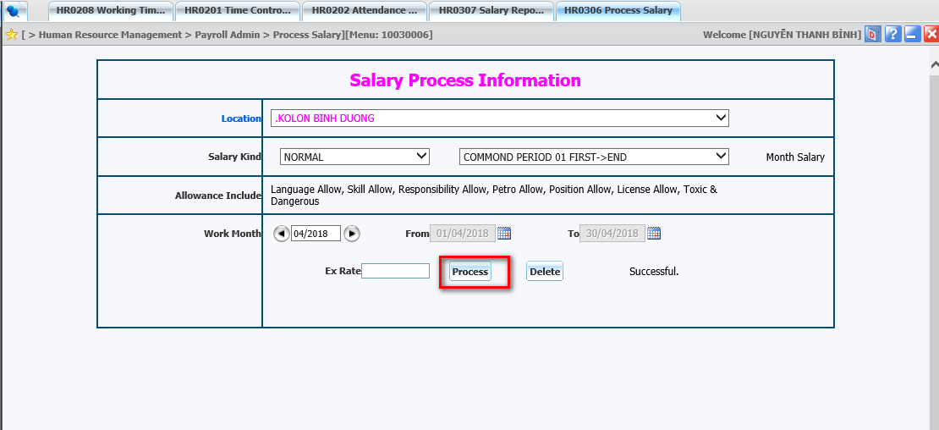
4. Incorrect Time Process
Users process in HR system to calculate salary

Slide 23
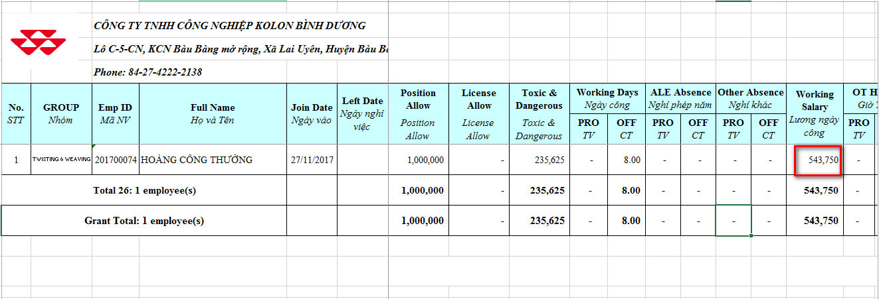
4. Incorrect Time Process
Users can check salary in salary payment of HR system

Slide 24
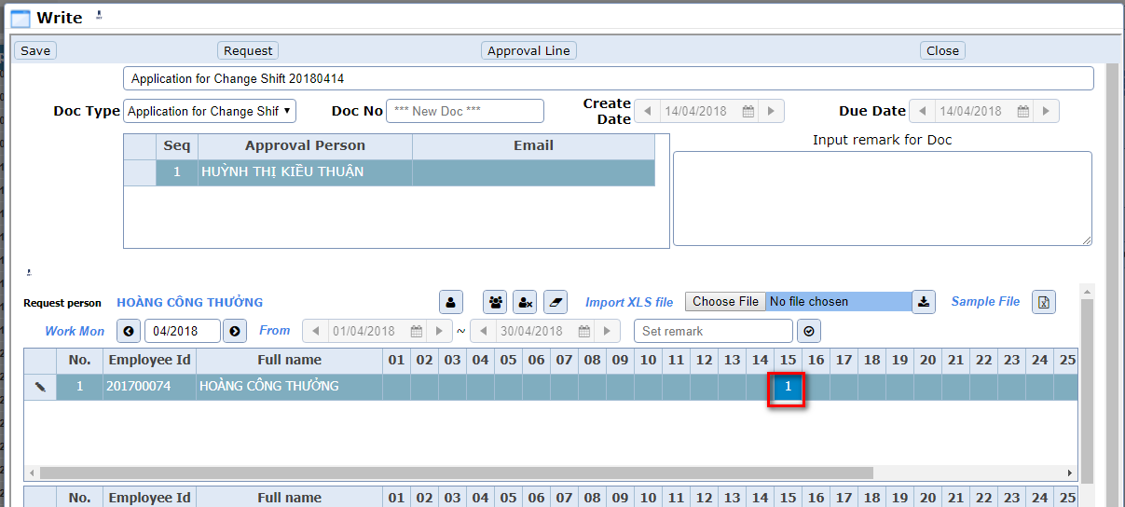
5. Change shift Process
Users register change shift application in e-approval

Slide 25
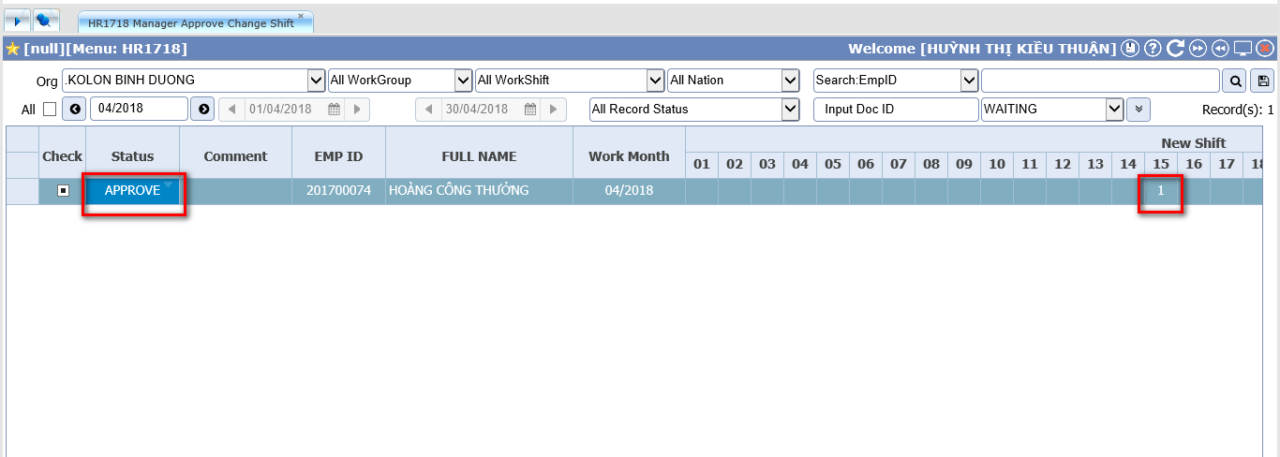
5. Change shift Process
Managers approve change shift application

Slide 26
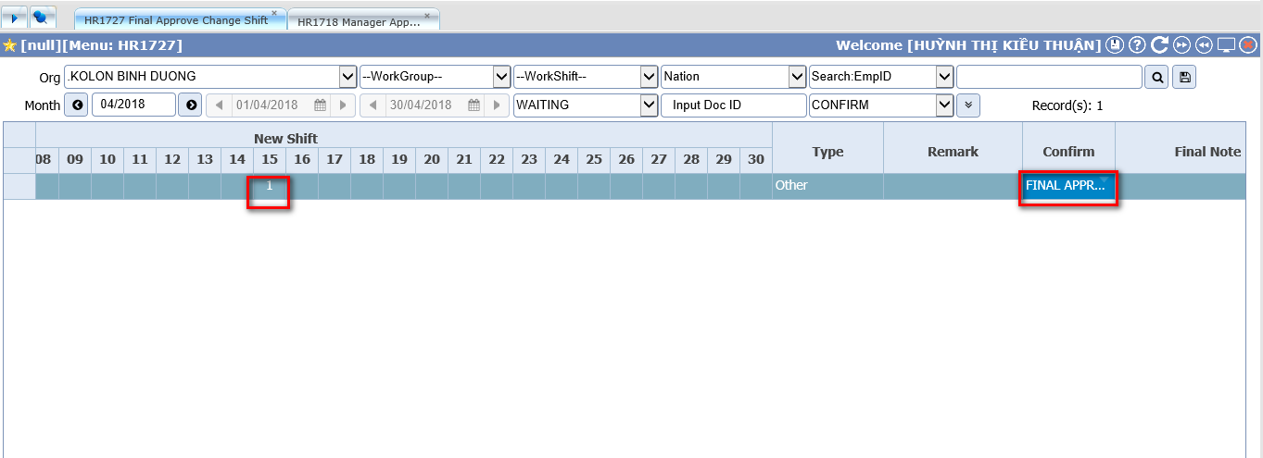
5. Change shift Process
HR staffs make final confirm

Slide 27
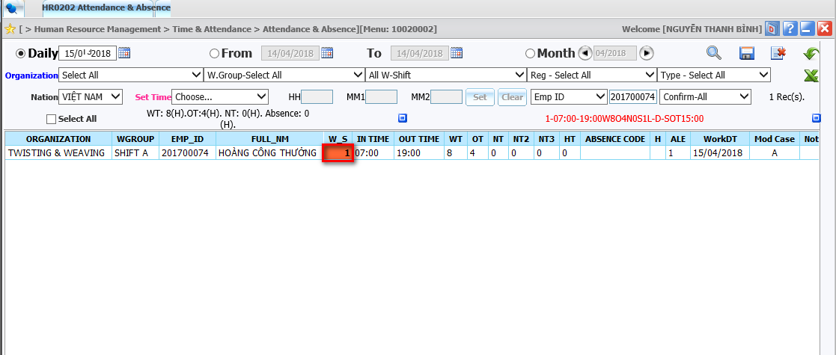
5. Change shift Process
Change shift data will be applied to attendance & absence of HR system

Slide 28
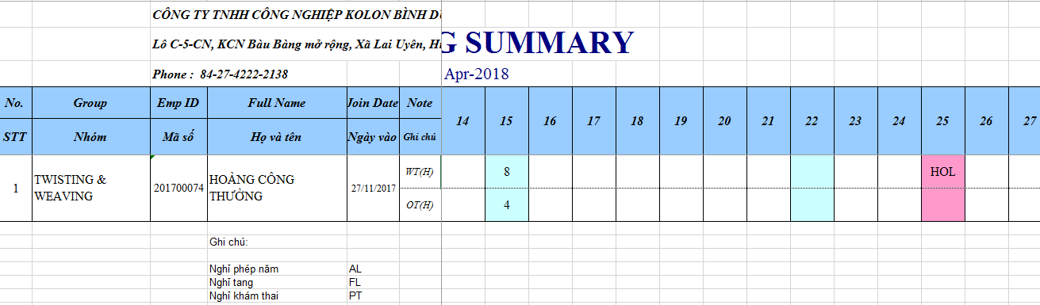
5. Change shift Process
After users process attendance. Change shift data will be displayed in working summary report

Slide 29
5. Change shift Process
Users process in HR system to calculate salary

Slide 30
5. Change shift Process
Users can check salary in salary payment of HR system

Slide 31
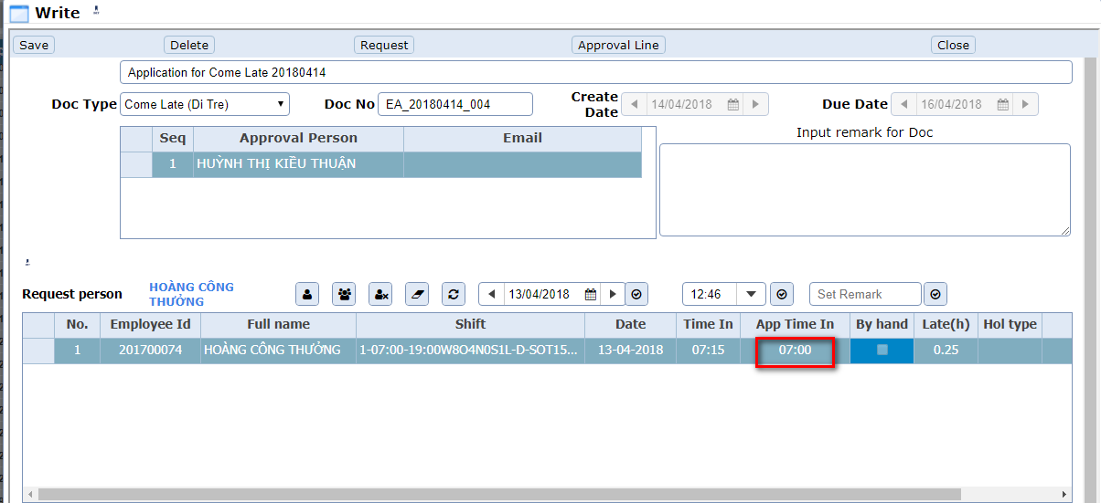
6. Come late Process
Users register come late application in e-approval

Slide 32
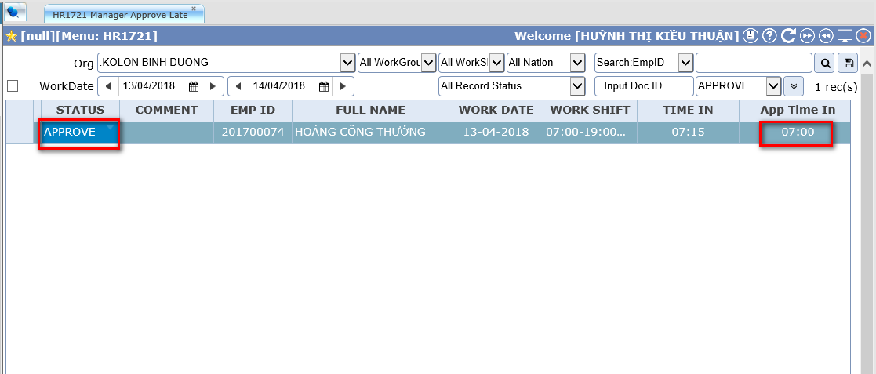
6. Come late Process
Managers approve come late application

Slide 33
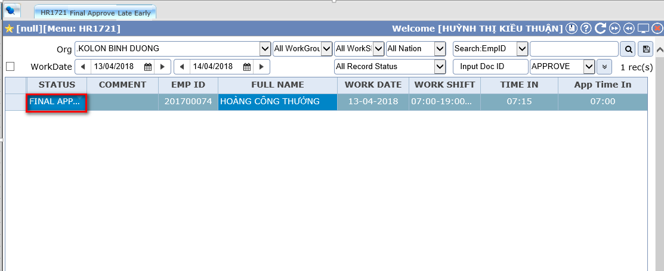
6. Come late Process
HR staffs make final confirm

Slide 34
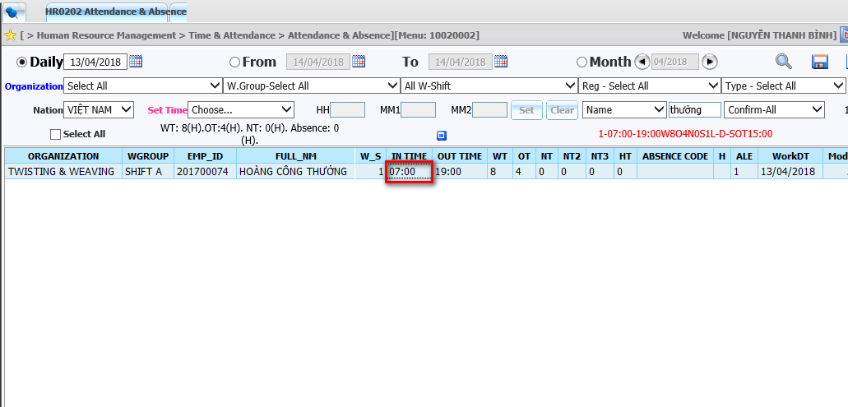
6. Come late Process
Come late data will be applied into attendance & absence of HR system

Slide 35
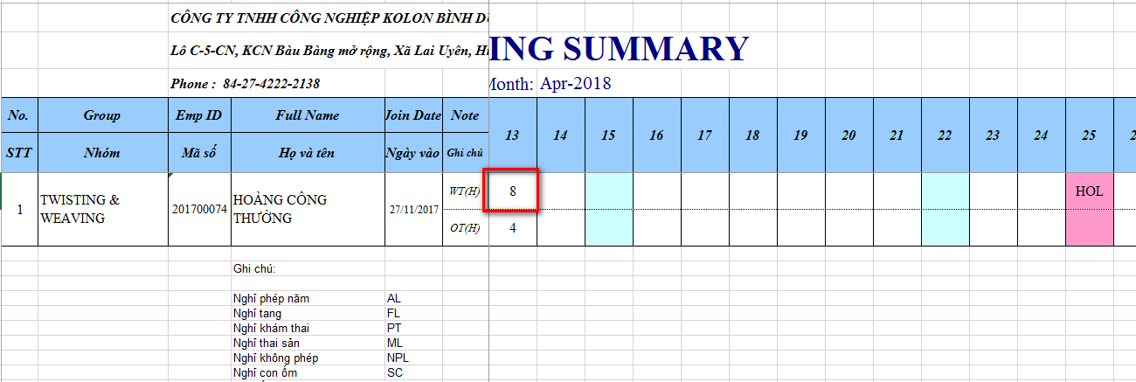
6. Come late Process
After users process attendance. Come late data will be displayed in working summary report

Slide 36
6. Come late Process
Users process in HR system to calculate salary

Slide 37
6. Come late Process
Users can check salary in salary payment of HR system

Slide 38
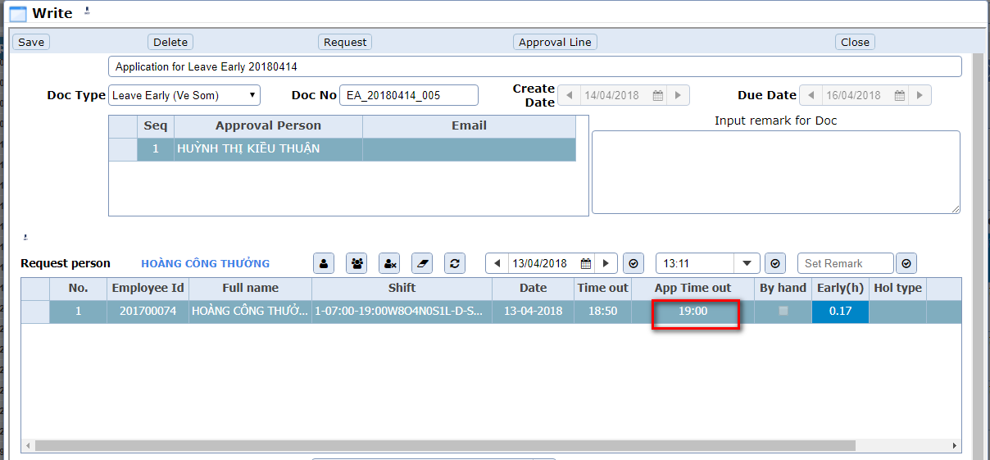
7. Leave early Process
Users register leave early application in e-approval

Slide 39
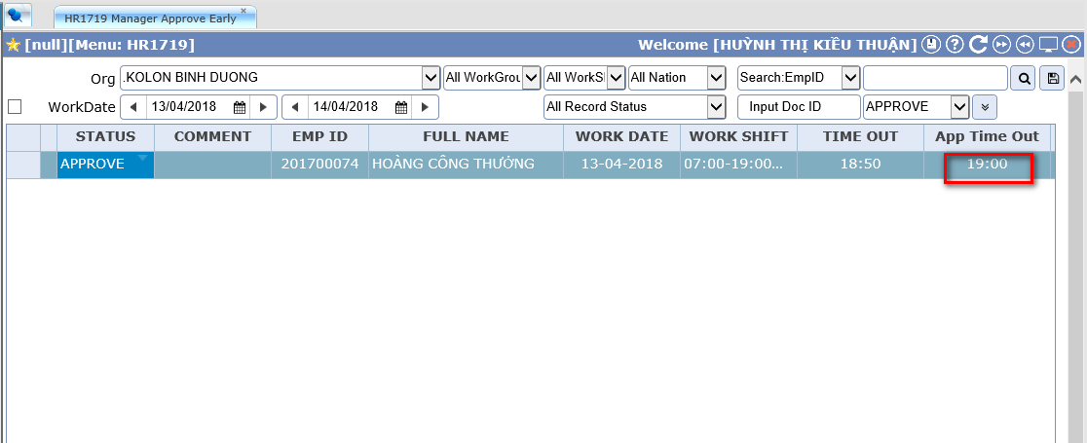
7. Leave early Process
Managers approve leave early application

Slide 40
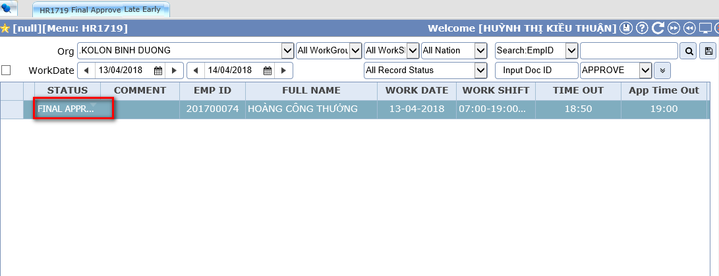
7. Leave early Process
HR staffs make final confirm

Slide 41
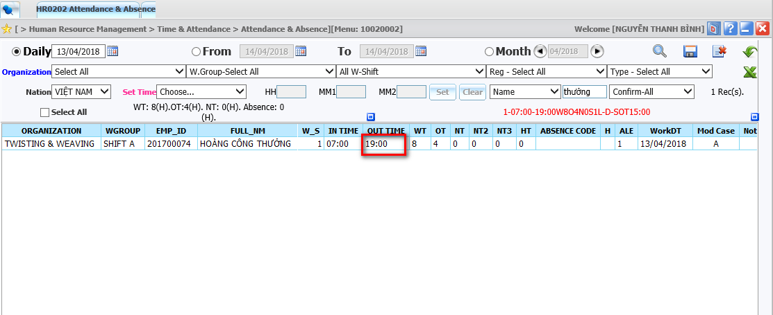
7. Leave early Process
Users can check salary in salary payment of HR system

Slide 42
7. Leave early Process
After users process attendance. Leave early data will be displayed in working summary report

Slide 43
7. Leave early Process
Users process in HR system to calculate salary

Slide 44
7. Leave early Process
Users can check salary in salary payment of HR system

Slide 45
Thank you for your attention

